Slide 1
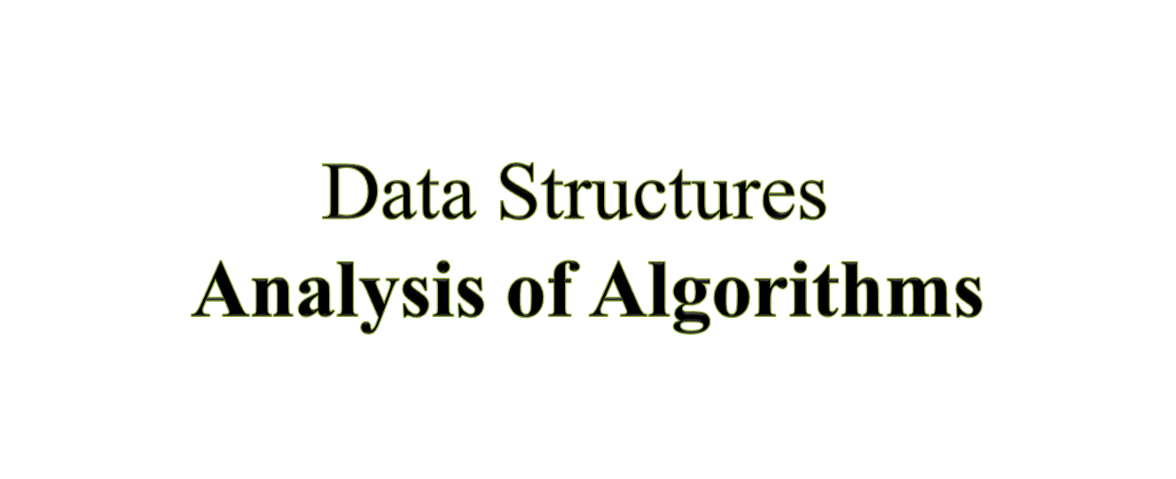

Slide 2
Outline
1. Introduction
2. Big-Oh and other Notations
3. Typical Growth Rates
4. Sum and Product Rules
5. Examples
6. Summary

Slide 3
What is a Good Algorithm?
The efficiency of an algorithm is measured by 2 important factors :
T(n): Time / Steps taken by an algorithm for input of size n
S(n): Space (memory cells) required by an algorithm for input of size n

Slide 4
Measuring the Running Time
How should we measure the running time of an algorithm?
Experimental Study
Write a program that implements the algorithm.
Run the program with data sets of varying size and composition.
Use command time to get an accurate measure of the actual running time.

Slide 5
Limitations of Experimental Studies
It is necessary to implement and test the algorithm in order to determine its running time.
Experiments can be done only on a limited sets of inputs, and may not be indicative of the running time on other inputs not included in the experiment.
In order to compare two algorithms, the same hardware and software environments should be used.

Slide 6
Beyond Experimental Studies
We will develop a general methodology for analyzing running time of algorithms. This approach
Uses a high-level description of the algorithm instead of testing one of its implementations.
Takes into account all possible inputs
Allows one to evaluate the efficiency of any algorithm in a way that is independent of the hardware and software environment.

Slide 7
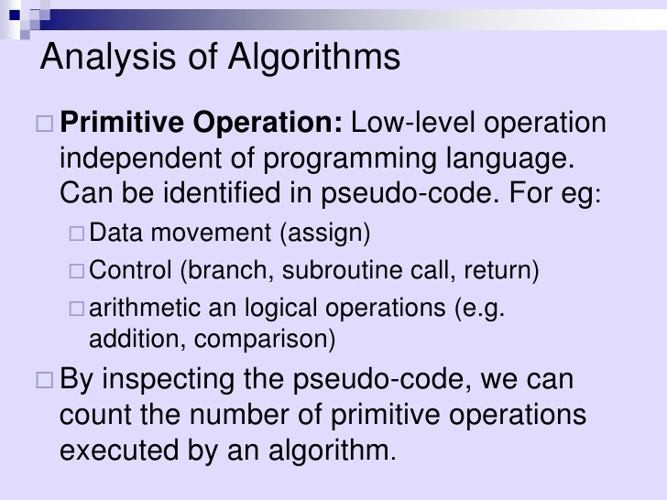

Slide 8
A Computational Model
To summarize algorithm runtimes, we can use a computer independent model
instructions are executed sequentially
count all assignments, comparisons, and increments
every simple instruction takes one unit of time (cost of executing instruction)

Slide 9
Simple Instructions
Count the simple instructions
assignments have cost of 1
comparisons have a cost of 1
let's count all parts of the loop
for (int j = 0; j < n; j++)
• j=0 has a cost of 1, j<n executes n+1 times, and j++
executes n times for a total cost of 2n+2
each statement in the repeated part of a loop have a cost equal to number of iterations

Slide 10
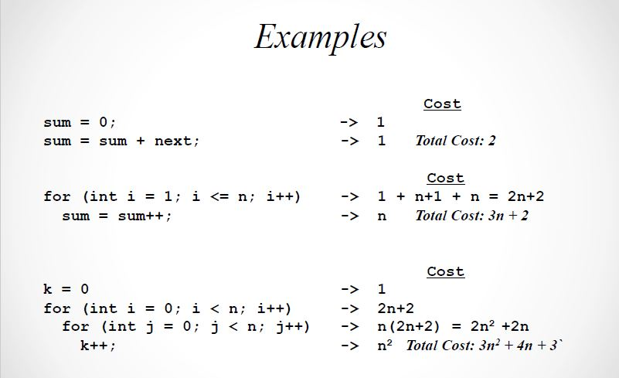

Slide 11
Cost
2n+2
n
0 or 1
0 or 1
Case Study: Linear Search
for(i = 0; i < n; i++)
if(item[i] == search_item); return i; //index of item found return -1; //if Not Found
Total Cost = 3n+3

Slide 12
Different Cases
The total cost of sequential search is 3n+3
- But is it always exactly 3n+3 instructions?
- How many times will the loop actually execute?
• that depends
- If search_item is found at index 0: _____ iterations
• best case
- If search_item is found at index n-1:_____ iterations
• worst case

Slide 13
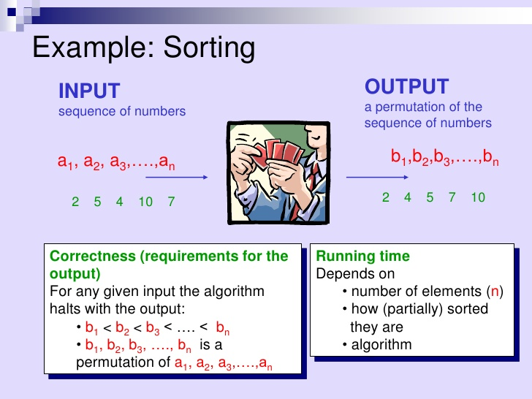


Slide 14
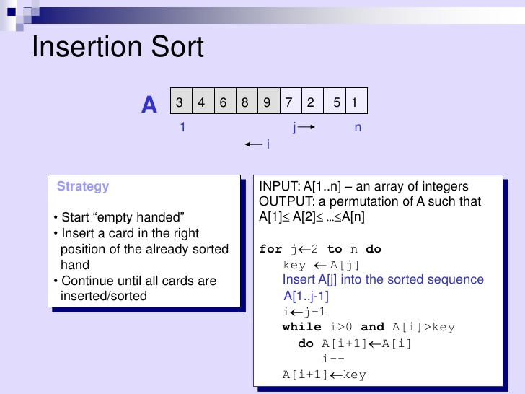

Slide 15
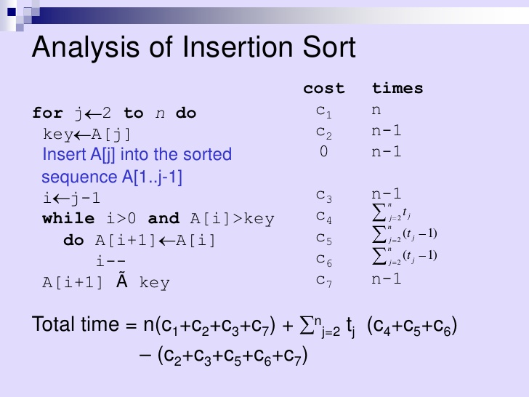


Slide 16
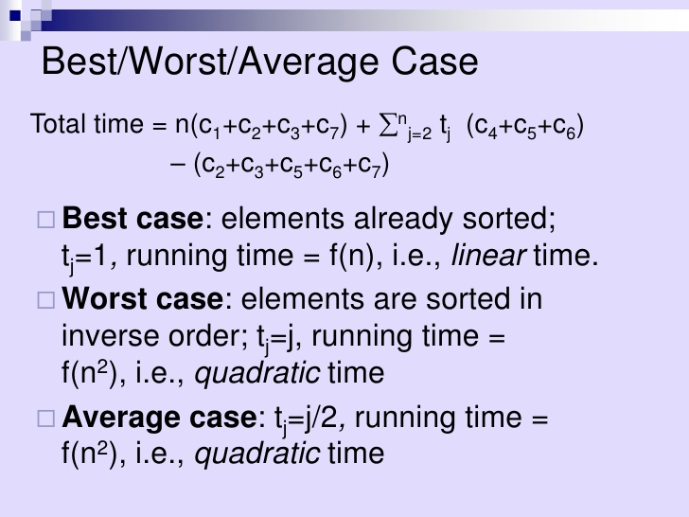

Slide 17
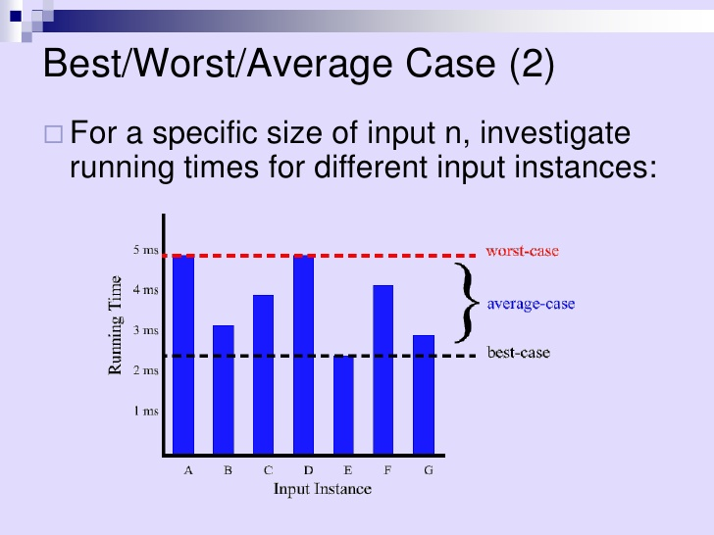

Slide 18
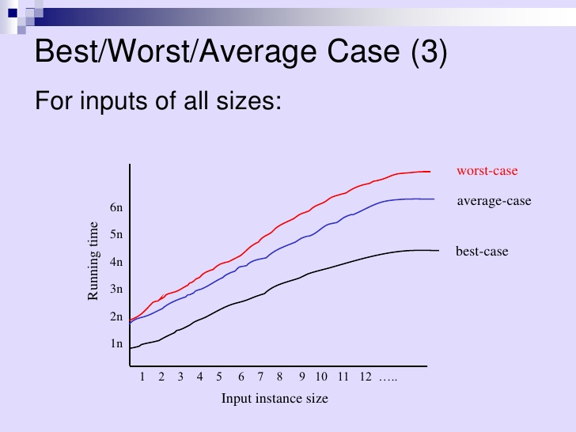

Slide 19
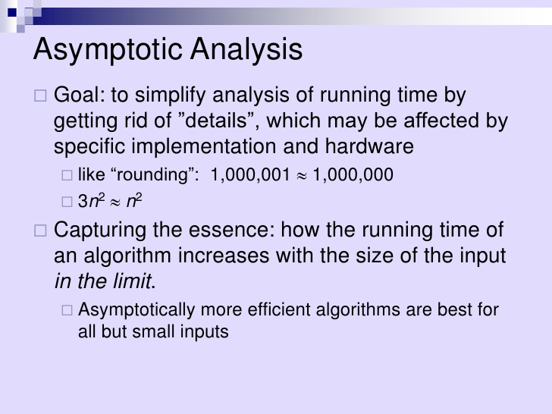

Slide 20
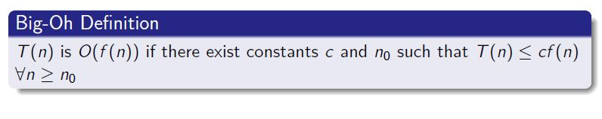
Big-Oh Notation

Slide 21
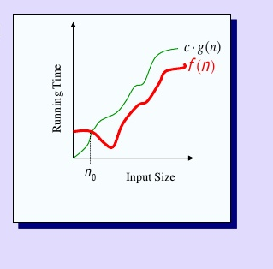
T(n) and f(n) are functions over non-negative integers.
Used for Worst-Case Analysis.

Slide 22
Big – Oh Example
Suppose T(n) = 3n³ + 2n²
Claim: For n₀ = 1 and c = 5, 3n³ + 2n² ≤ 5n³, Ɐn ≥ 1
Such a claim may be proved using Mathematical Induction
If this claim is true, then the complexity (growth rate) can be expressed as O(n³)
Technically, we can also say that this T(n) is O(n⁴)
But, that is a weak statement, and it is understood that we need to find the “least upper bound”

Slide 23
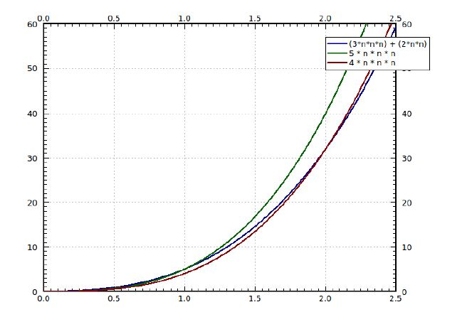
Big-Oh Example
Figure: Big-Oh Illustration

Slide 24
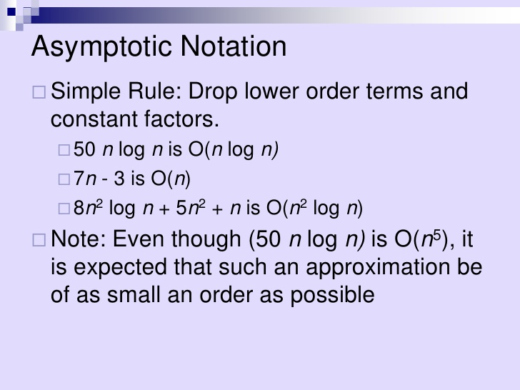

Slide 25
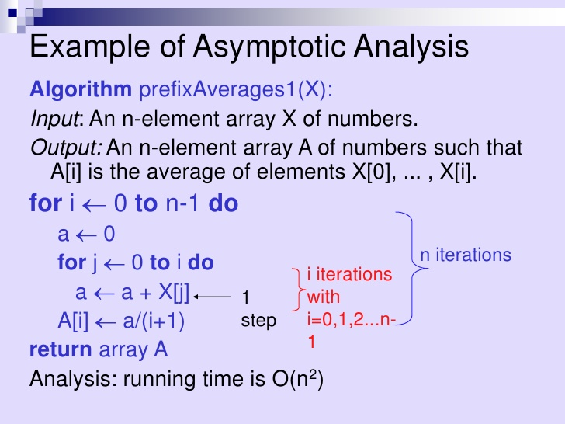

Slide 26
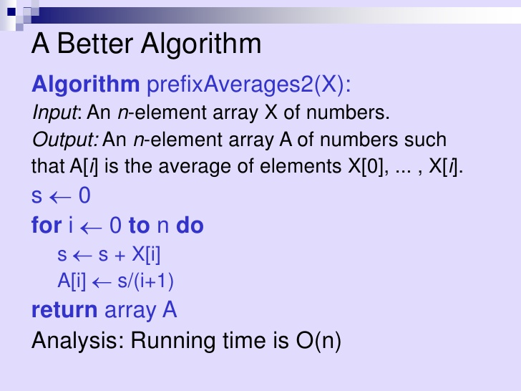

Slide 27
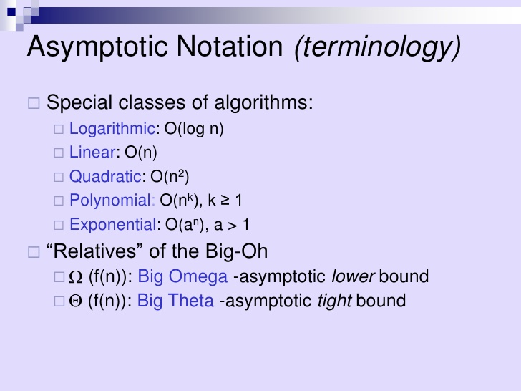

Slide 28
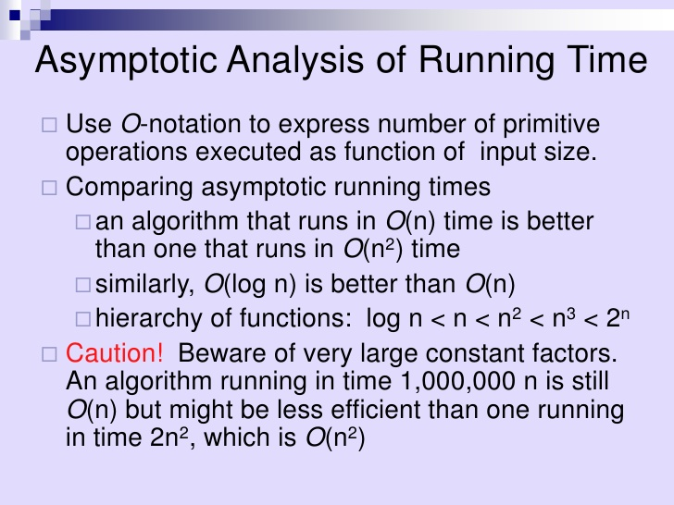

Slide 29
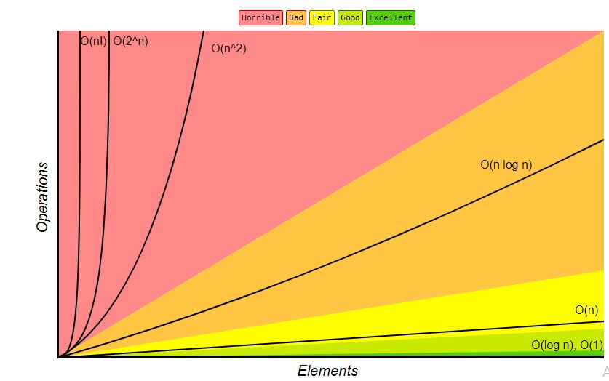
Big 0 Complexity Chart

Slide 30
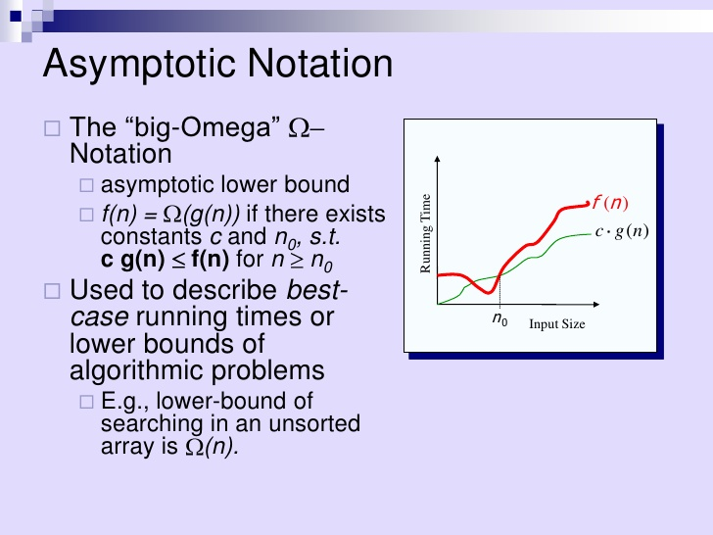

Slide 31
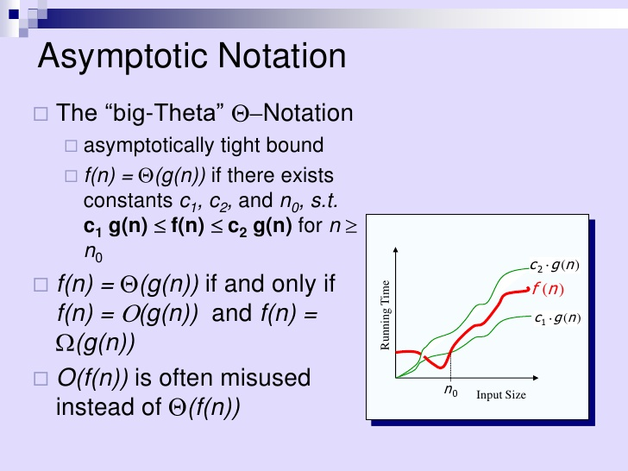

Slide 32
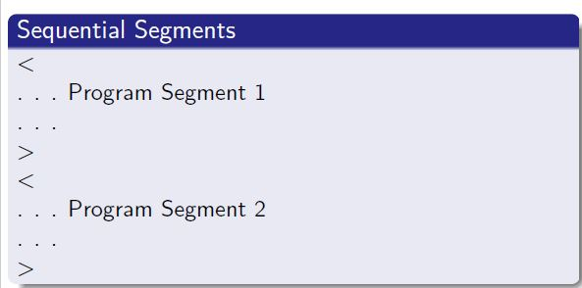
Rule of Sums
T₁(n)
T₂(n)
T(n) = T₁ (n) + T₂(n)
Sum Rule
Suppose T₁(n) is O(f(n)) and T₂(n) is O(g(n)), then T(n) is O(max(f(n), g(n))

Slide 33
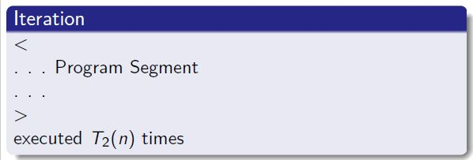
Rule of Products
T₁(n)
T(n) = T₁ (n) × T₂(n)
Product Rule
Suppose T₁(n) is O(f(n)) and T₂(n) is O(g(n)), then T(n) is O(f(n)g(n))
Note that O(cf (n)) is same as O(f (n))!

Slide 34
Empirical Verification: Ratio Analysis
Is it possible to empirically verify if the running time of an algorithm is O(f (n))?
Implement the algorithm and note down the running time T(n) for different values of n.
Now find the ratio T(n)/f (n) , for those different values on n.
f (n) is a tight bound if this ratio converges to a positive constant
If the ratio converges to 0, then f (n) is an over-estimate
f (n) is an under-estimation, if this ratio diverges.

Slide 35
Summary
Time / Space complexity of an algorithm are expressed in notations such as Big-Oh and Big-Theta
These notations bring out the growth rate of time / space wrt the size of the input
These notations enable us to avoid exact calculations of number of “basic steps” or memory space required — overall growth rate can be estimated based on growth rates of components
It is possible to come up with several designs of algorithms for a problem, and analysis is important to choose the appropriate one
It is also possible to perform empirical ratio analysis to determine / verify time complexity of an algorithm

Slide 36
What Next?
We will take analysis of recursive algorithms in the next lecture
Meanwhile, read on complexity analysis of algorithms from standard Books
Later in this week, we will start our discussions on implementation of linear structures
Topics like trees, graphs, sets, and hashing will follow that

